Slide 1
WE KNOW YOUR AGE

Slide 2
Hook
You may have taken some quizzes to find out something about you, and based on your answers, they would tell you things about yourself, such as “Which magical animal are you?” or “Who is your soul mate?”
What if we can guess your age? Let’s see how we will try to do that.
Age prediction based on various survey questions

Slide 3
Literature Review + Dataset + Roadmap
Cite the source
The data contains missing values.
The survey was presented to participants in both electronic and written form.
All participants were of Slovakian nationality, aged between 15-30.
The variables were split into groups

Slide 4
Interesting Non-Regression Facts
Histogram of Age
For the survey questions that were rated 1-5, we treated it as quantitative variable.

Slide 5
Josh’s Intuition
The interpretation of the distribution of any particular question is:
Large percentage of responses = “3” means overall weak opinion of the question
Only include survey questions that have less than 20% of the responders choose “3”.
A survey question’s distribution with higher variance would be indicative of clusters of responders of similar age.
Use these variables, along with all qualitative and quantitative survey questions to predict Age via regression.

Slide 6
Josh’s Methodology
Filter variables if less than 200 survey takers answered “3”
Variables reduced from 149 to 50.
Stepwise Algorithm to detect significant variables
Variables reduced from 50 to 10.
Brute Force Algorithm to discover optimal solutions
Prediction: 9 Variable Model: R²_{jack} = 0.4704
Descriptive: 10 Variable Model: R²_{adjusted} = 0.4810
AIC: 10 Variable Model: AIC = 4102.3267

Slide 7
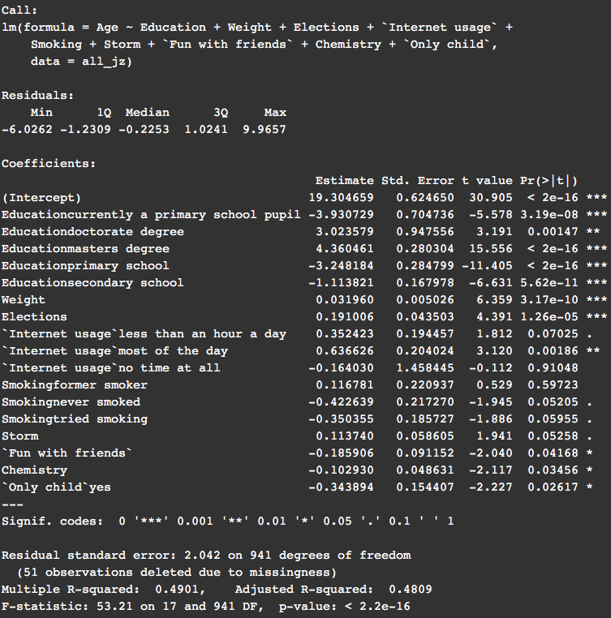
Interpretations
Note:
Unless eloquated below, all beta coefficients are logical by common sense.
Education seems to be very significant in determining a person’s age. This is as expected.
The coefficient for weight suggests that someone 1 year older will weigh 1/0.032 = 31.25 pounds more, which seems a little bit high.
A phobia of storms (Storm) increases with age. On the one hand, children may be scared of a storm’s ferocity, but storms could cause property damage for people who are older.
Having fun with friends is more important for younger people. A moment for the loss of innocence.

Slide 8
Conclusions and Future Work
In 2013, students of the Statistics class at FSEV (Faculty of Social and Economic Sciences, Comenius University in Bratislava) UK were asked to invite their friends to participate in this survey
All participants were Slovakian nationality, aged between 15-30.

